Slide 1
CLC 3
Ryan Coon Allen Atkins Carrie Assalone

Slide 2
Recursion Trees
Recursion Tree Method is a pictorial representation of an iteration method which is in the form of a tree where at each level nodes are expanded.
In general, we consider the second term in recurrence as root.
It is useful when the divide & Conquer algorithm is used.
It is sometimes difficult to produce a good guess. In Recursion tree, each root and child represents the cost of a single subproblem.
We sum the costs within each of the levels of the tree to obtain a set of pre-level costs and then sum all pre-level costs to determine the total cost of all levels of the recursion.
A Recursion Tree is best used to generate a good guess, which can be verified by the Substitution Method.

Slide 3
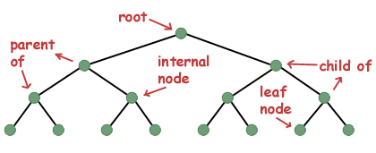
Parts of a tree

Slide 4
Three of most common ways to traverse a tree are known as in-order, pre-order, and post-order.
An in-order traversal visits each of the nodes in order
In a preorder traversal, we first print ourself, then we print all the nodes to the left of us, and then we print all the nodes to the right of ourself.
In a post-order traversal, we visit everything to the left of us, then everything to the right of us, and then finally ourself.

Slide 5
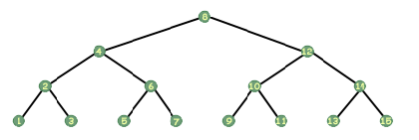
It may seem that the in-order traversal would be difficult to implement. However, using recursion it can be done in four lines of code.
void print_inorder(tree_t *tree) {
if (tree!=NULL) {
print_inorder(tree->left); printf("%d\n", tree->data); print_inorder(tree->right); }
}

Slide 6
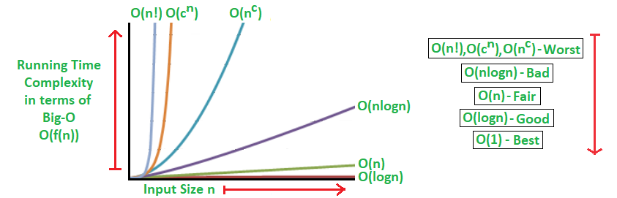
Trace Recursive Algorithms
Big O-Notation
Constant Time is “order 1” : 0(1)
Linear Time is “order 2” : 0(N)
Quadratic Time is “order N squared: 0(N^2)
Definition: Let g and n be functions from the set of natural numbers to itself.
if there is a Constant: f 0(g) c > 0
and a Natural Number n₀ such that
f(n) ≤ cg(n) for all n >= n₀ .

Slide 7
Trace Recursive Algorithms
Steps to BIG-O Notation analysis: “Find Run Time”
Figure out what the input is and what n represents.
Express the maximum number of operations, the algorithm performs in terms of n.
Eliminate all excluding the highest order terms.
Remove all the constant factors.
The BIG-O Analysis for any algorithm should be straightforward as long as the operations are correctly identified that are dependent on n, and the input size.
Fastest possible run time: 0(1) – Constant Running Time
Performance time depends on n, the size or input or number of operations for required for each input item.
Best Run Times Worst Run Times
O(logn) O(n^{c})
O(n) O(c^{n})
O(nlogn) O(n!)
T

Slide 8
Trace Recursive Algorithms
Ideal Algorithm – O(1) – Linear Search, Binary Search, Bubble Sort, Selection Sort, Insertion Sort, Heap Sort, Shell Sort.
Log Algorithm – O(log n) – Merge Sort.
Linear Algorithm – O(n) – Quick Sort.
Sub-Linear Algorithm – O(n+k) – Radix Sort.
Examples:
Logarithmic algorithm – O(log n) – Binary search
Linear algorithm – O(n) – Linear search
Superlinear algorithm – O(nlogn) – Heap sort, Merge Sort.
Polynomial algorithm – O (n^c) - Strassen’s Matrix Multiplication, Bubble Sort, Selection Sort, Insertion Sort, Bucket Sort.
Exponential algorithm – O (c^n) – Tower of Hanoi.
Factorial algorithm – O(n!) – Determinant Expansion by Minors, Brute Force Search algorithm for Travelling Salesman Problem.

Slide 9
Sorting Algorithm
A Sorting Algorithm is used to rearrange a given array or list elements according to a comparison operator on the elements. The comparison operator is used to decide the new order of element in the respective data structure.

Slide 10
Sorting Algorithm
5 Popular sorting algorithms in Java
Merge Sort – uses the divide and conquers strategy for sorting elements in an array.
Heap Sort – a complete binary search tree where items are stored in a special order depending on the requirement.
Insertion Sort – one picks up an element and considers it to be the key. If the key is smaller than its predecessor, it is shifted to its correct location in the array.
Selection Sort – sorts an array by repeatedly finding the minimum element (considering ascending order) from unsorted part and putting it at the beginning.
Bubble Sort - works by repeatedly swapping the adjacent elements if they are in wrong orde

Slide 11
Heap Sort Algorithm
This algorithm has two main parts:-
heapsort()
Heapify()
Notes:
heapSort() – This function helps construct the max heap initially for use. Once done, every root element is extracted and sent to the end of the array. Once done, the max heap is reconstructed from the root. The root is again extracted and sent to the end of the array, and hence the process continues.
heapify() – This function is the building block of the heap sort algorithm. This function determines the maximum from the element being examined as the root and its two children. If the maximum is among the children of the root, the root and its child are swapped. This process is then repeated for the new root. When the maximum element in the array is found (such that its children are smaller than it) the function stops. For the node at index i, the left child is at index 2 * i + 1, and the right child is at index 2 * i + 1. (indexing in an array starts from 0, so the root is at 0).

Slide 12
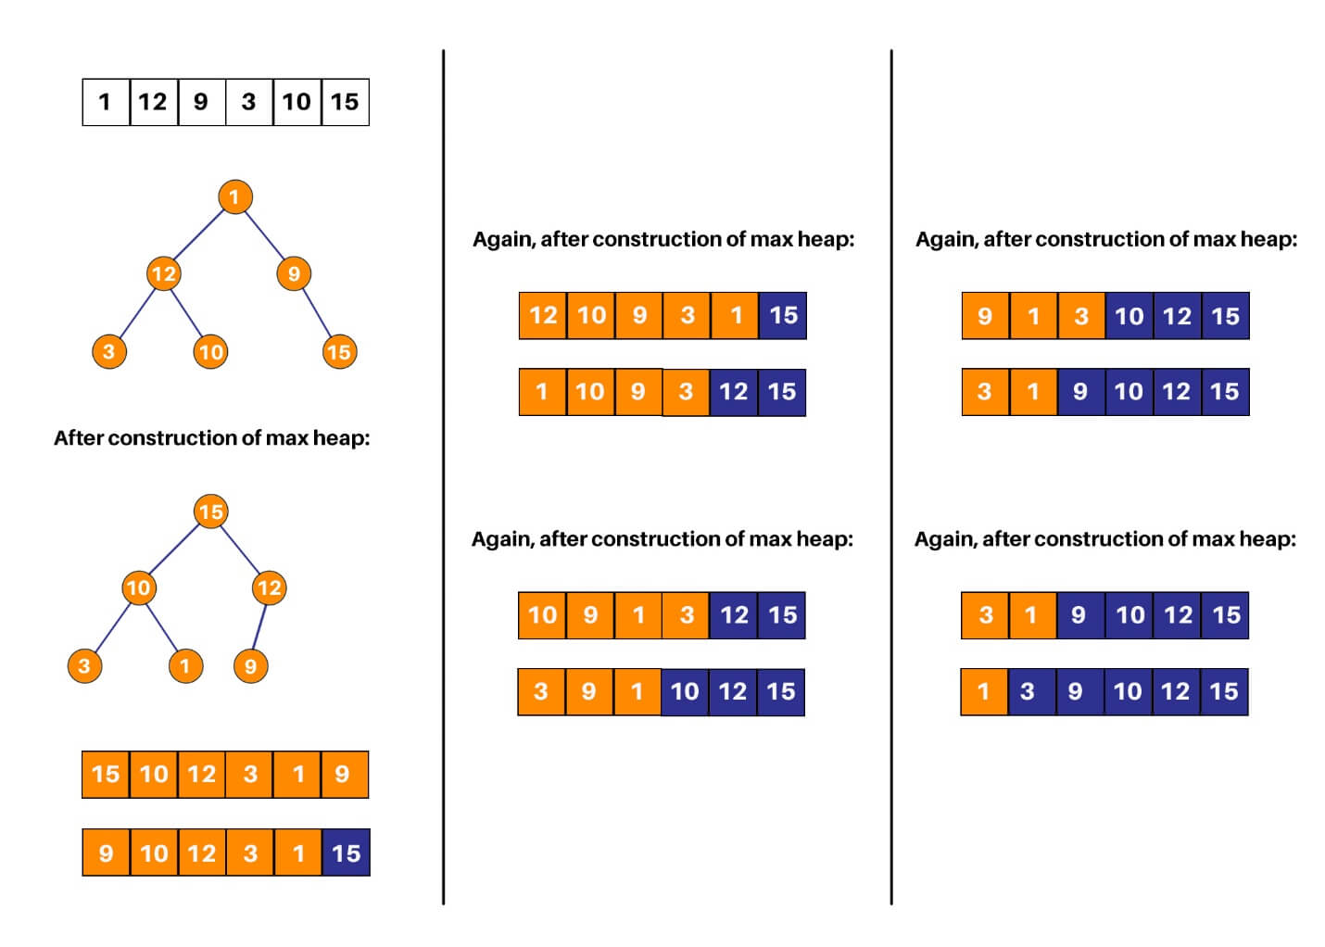
Heap Sort Algorithm

